Slide 1

Access Control
Group 3
Karmdeep Kaur
Dwity Gohil
Ripunjoy Madhab buddha

Slide 2
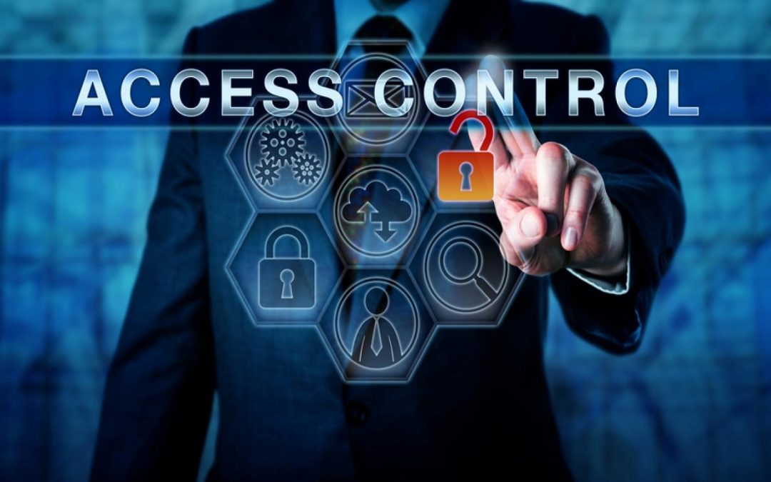
what is access control?
Access control systems deliver basic security features that regulate user permissions. They make use of technologies such as passwords, biometrics, and security certificates.

Slide 3
Access control based on The Three (3) A’s (and One I) of Access Control
Access control systems are a fundamental part of any organization’s identity-proofing.
To better understand access control, we can take a deeper look into the four basic elements—identification, authentication, authorization, and accountability.

Slide 4
Identification –
Identification is the starting point, where the users provide
information about their identity.

Slide 5
How Is Identity Verified?
A secure identity should be distinct in the sense that it should be possible for two users to identify themselves clearly.
The list that follows highlights the key concepts of identity.
Identities should be unique. Two users with the same identity should not be allowed.
2. Identities should be nondescriptive. It should not be possible to infer the role or function of the user.
3. Identities should be securely issued. A secure process for issuing an identity to a user needs to be established.
4. Identities can be location-based. A process for authenticating someone based on his or her location.

Slide 6
Authentication – Authentication is any process by which a system verifies the identity of a user who wishes to access the system.
Entering a password, using a digital or physical key, and providing a biometric measure for accuracy are some of the ways to do this effectively.
The disadvantage of using this method is that once the information is lost or stolen (for example, if a user’s password is stolen), an attacker would be able to successfully authenticate.

Slide 7
Authentication by Knowledge –
When the user offers a secret that only they know, that is known-only authentication by knowledge. A password, PIN code, or security question provided by the user would be examples of knowledge-based authentication.

Slide 8
Authorization – When a user has successfully established their identity, pre-determined permissions are granted to them during the authorization stage.
How to prevent access –
Default access privileges will be set to default deny (deny all).
Access to information and information systems must be limited to personnel and processes with a need-to-know to effectively fulfill their duties.
Access permissions must be based on the minimum required to perform the
job or program function.
4. Information and information system owners are responsible for determining access rights and permissions.
5. Permissions must not be granted until the authorization process is complete.

Slide 9
Authentication by Ownership or Possession –
With this type of authentication, the user is asked to provide proof that he owns something specific.
—for example, a system might require an employee to use a badge to access a facility. Another example of authentication by ownership is the use of a token or smart card.
Possession – The most common of the four is the one-time passcode sent to a device in the user’s possession.

Slide 10
Authentication By Characteristics -
Authentication by characteristic, often known as a biometric attribute, authentication verifies the user based on a physical or behavioural characteristic. The following physical or physiological traits are the most prevalent:
1. Fingerprint
2. Face recognition
3. Retina and iris
4. Palm and hand geometry
5. Blood and vascular information
6. Voice recognition

Slide 11
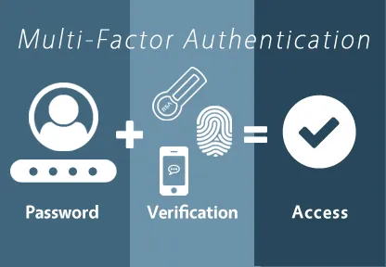
Multi-Factor Authentication – When only one factor is provided, it is known as single-factor authentication.
An authentication method that requires the user to provide two or more verification factors to gain access to a resource such as an application, online account, or a VPN

Slide 12
Accountability Or Auditing
Accountability or audit are the last two components of the access control system. Your system can offer logs at this point so that users and permissions can be audited. By doing this, you can track what happened if something goes wrong, including what data was accessed or downloaded and how long each task took.
An authorization policy should implement two concepts:
Implicit deny: If no rule is specified for the transaction of the subject/object, the authorization policy should deny the transaction.
2. Need-to-know: A subject should be granted access to an object only if the access is needed to carry out the job of the subject.

Slide 13
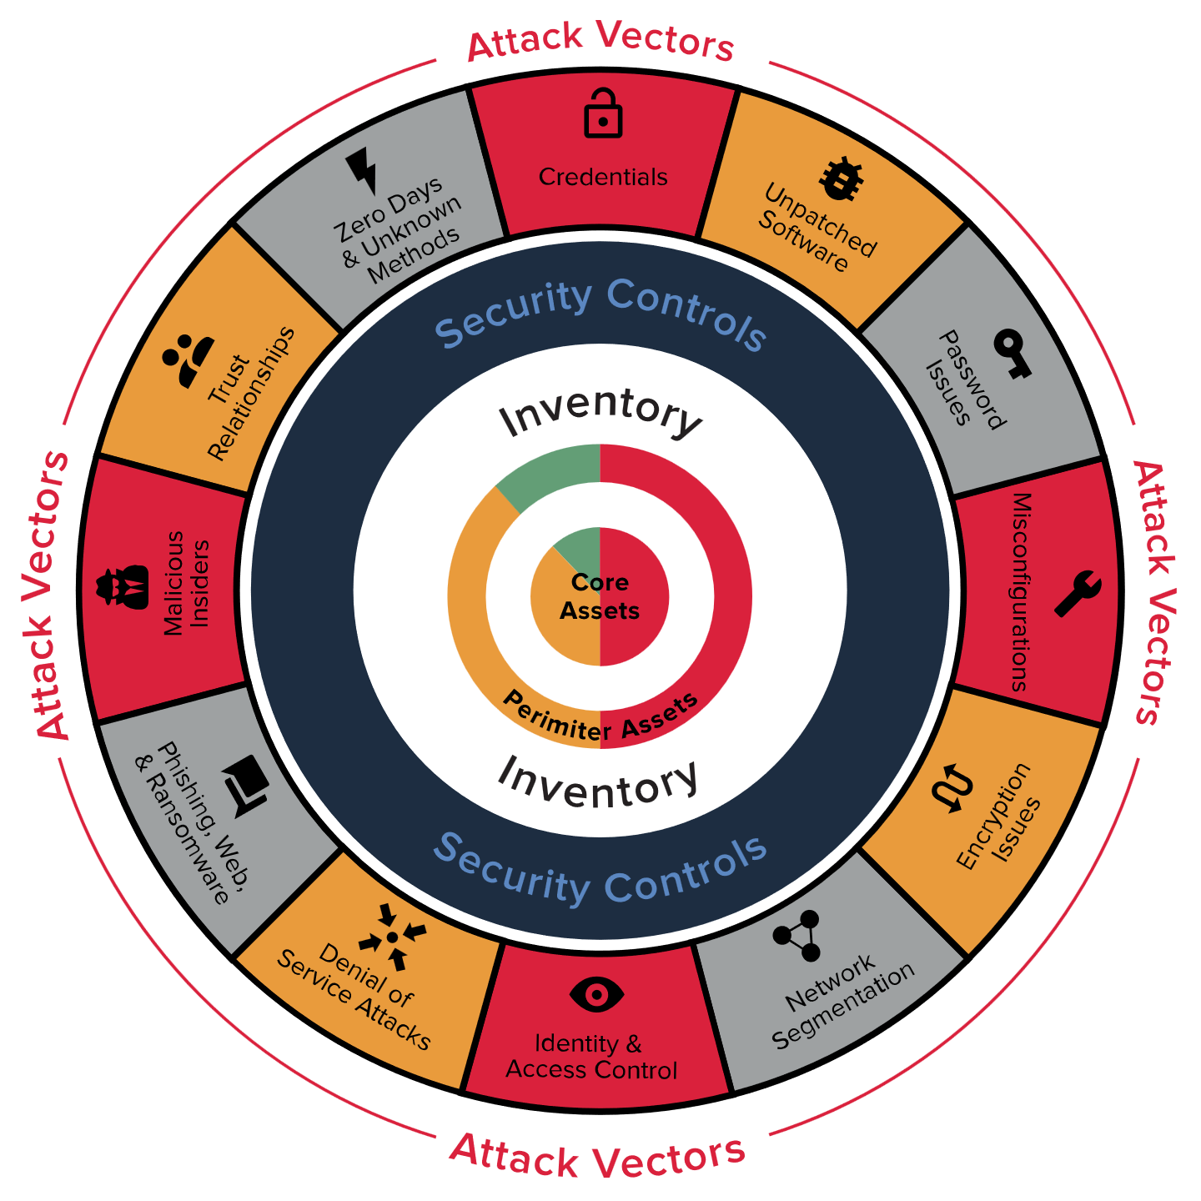
What Is a Security Posture?
A security posture is an organization’s approach to access controls based on information about an object, such as a host (end system) or network.

Slide 14
Infrastructure Access Control
What is infrastructure network?
What is Infrastructure Access control?
What types of controls are included?

Slide 15
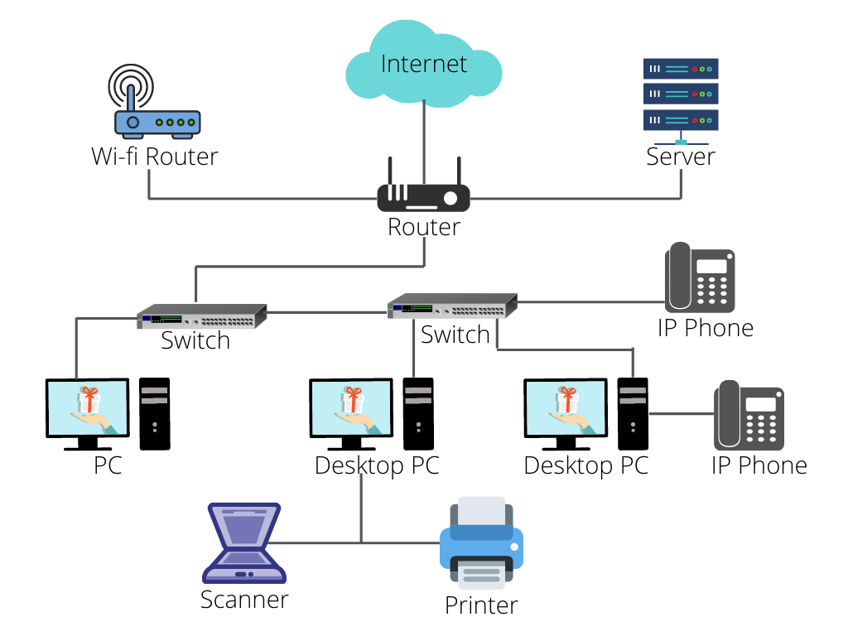

Slide 16
Why Segment a network?
What is Network classification?
The ability to implement different services, authentication requirements and security measures is made possible through segmentation.

Slide 17
Types of Segmented Network
Enclave network
Trusted Network (Wired/Wireless)
Semi Trusted Network
Guest Network
Untrusted Network

Slide 18
Technologies used to segment a Network
Virtual LANs (VLANs)
Security Group Tagging (SGT)
VPN Routing and Forwarding (VRF)
vMicro-segmentation at the virtual machine level
Micro-segmentation for containers

Slide 19
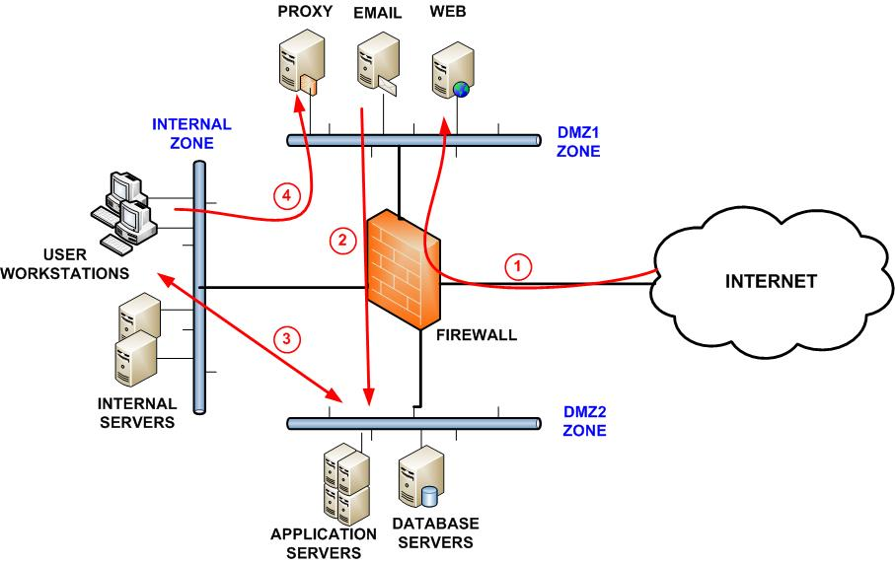
Layered border security
What is layer security?
What is layered border security?
It includes controls like firewalls,

Slide 20
Firewalls
What is a firewall?
Firewalls are handled and configured with procedures and rule sets to control incoming and outgoing traffic.
Without it, the network is completely exposed and can be compromised.

Slide 21
The process used to allow or block traffic includes:
Simple packet filtering techniques
Application Proxies
Network Address Protocol
Stateful inspection firewalls
Next-gen context-aware firewalls

Slide 22
Intrusion Detection and Prevention
When malicious activities masquerade legitimate traffic these are used.
IDS is a passive to analyze traffic to detect unauthorized access, and stressful protocol analysis and if it detects anything IDS generates an email, message or text alert.
IPS is an active device which seats in line with traffic and responds to identify threads by disabling connection, dropping packets or deleting malicious content.

Slide 23
Technologies used by IDS/IPS
Network-based: Monitors network traffic for a specific segment, and device and analyze activities.
Wireless IDS/IPS: Monitors wireless network traffic and analyzes activities and protocols.
Network behavioural analysis: It examines the traffic to identify threats, information flow, DDOS, malware and policy violations.
Host-based IDS/IPS: It monitors every single host and its events.

Slide 24
Decision States
True positive: It correctly identifies an issue.
True Negative: It correctly identifies normal traffic.
False Positive: Incorrectly identifies normal activity as an issue
False Negative: Incorrectly identifies an issue as normal activity.

Slide 25
Methodologies used by IDS/IPS for detection:
Pattern matching and stateful pattern matching recognition
Protocol analysis
Heuristic-based analysis
Anomaly-based analysis
Correlation protection capabilities based on threat intelligence

Slide 26
Content filtering & whitelisting/Backlisting
Content Filtering: Allow or restrict access based on its content.
Whitelist: Specific sites have access
Blacklist: Where access is denied
It commonly blocks the entire range of IPS specific to geographic locations
Restrict the access by content categories.

Slide 27
Border device administration and management
Everything has to be monitored- Logs and alerts must be monitored and analyzed (successful and unsuccessful both)
Policies need to be updated as per requirements.
Detail examination of all changes since the last review.
External pen testing is used to verify the device’s performance.

Slide 28
Types of Security groups
Blue teams: Defenders of the corporate network which includes SOC, CSIRTS, Infosec teams
Red Teams: Ethical hackers, Pen testers who identify vulnerabilities, attack detection and response capability of the device.
Purple Team: When Red and Blue teams aligned forces to completely defend the organization.

Slide 29
Remote access security
It has controls like authentication, which must be chosen carefully based on network-segmented information and classification that is accessible.
It follows CIA triads:
Restricted information can’t be accessible to unauthorized parties, detecting good and bad modifications and ensuring the user can access required resources,
It must include physical control of client devices.

Slide 30
Remote access technologies
VPN: Secure tunnel for transmitting data through the internet.
Achieved through tunnelling and encryption. To provide high security without the high cost of private lines. It is connected between physical or remote sites.

Slide 31
Remote access authentication and authorization
Implement mutual authentication so they can verify legitimacy before providing authentication credentials.
MFA is required for access
Additionally users should require authentication periodically in remote access devices, they should ensure that they made the baseline required for internal systems.

Slide 32
Network access control
Used to check remote access device based on its criteria, if it doesn’t meet specific criteria access is denied.

Slide 33

Teleworking access control
Allows users to work offsite. Often from home or other locations.
Access company recourses by VPN
Equipment's should be provided by company to have proper access control
Special Access policy and standards will be in action

Slide 34
Teleworking Benefits
Reduction in vehicle pollution
Improved work-life balance
Reduced dependency on imported oils
New opportunities
Establishment of distributed workflows

Slide 35

User Access Control
Business can’t run without users
Clients or Customers
Employees
HR
IT
Marketing
Managers
Owners
Board Members

Slide 36
What is User Access Control?
Ensure that a user can ACCESS only SPECIFIC INFORMATION or SPECIFIC CONTROL in an organization or company.
Controls such as –
System administrators can only access to the active directories, CRUD users
Database administrators have direct access to all the databases
HR Team controls employee information

Slide 37

Why User Access Control?
Humans are naturally curious
If we don’t set user controls, Information confidentiality and Integrity will be in danger.
To protect data and information User Access controls are used

Slide 38
How to implement User Access Control?
Identifying account types (individual, group, system, application, guest, and temporary)
Establishing conditions for group membership Identifying authorized users of the information system and specifying access privileges
Requiring appropriate approvals for requests to establish accounts
Establishing, activating, modifying, disabling, and removing accounts
Specifically authorizing and monitoring the use of guest/anonymous and temporary accounts
Granting access to the system based on A valid access authorization

Slide 39

Least Privilege or Zero Trust
Trust no one. Both inside and outside of the network.
Grant minimum access to data, tools and information
Follows the rule Default deny

Slide 40
Access Controls in AWS, AZURE and operating systems
AWS uses Identity management
Azure uses RBAC (Role-based access control)
Operating systems such as Linux use Users and Groups and give specific permissions (Read, Write, Execute) for managing access control.

Slide 41
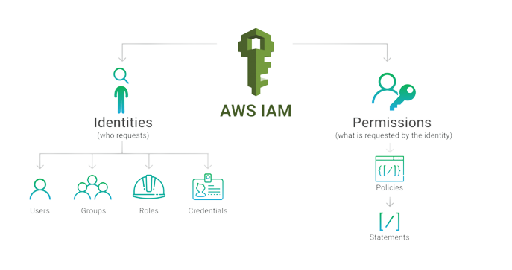
Identity Access Management

Slide 42
User Access common policies
Default user access permissions will be set to default deny
Access to company information and systems will be authorized only for workforce personnel
Access will be restricted to the minimal amount required to carry out the business requirement of the access.
An authorization process must be maintained.

Slide 43
Privileged controls
Accounts with elevated capabilities beyond regular users.
Network Administrators,
System Administrators,
Database Administrators,
Firewall administrators

Slide 44
Major note on privileged access
Administrative accounts should be accessed only when the activity being performed requires elevated rights and permissions.
No need to use for basic routine activities such as –
Checking email
Surfing internet
If someone logs in as a administrator and the computer is infected with malicious code, then the master of the malware can have root access.
Every user should have a second account with non privileged access

Slide 45

Separation of Duties
Concentration of Power on one hand can be dangerous
Tasks are assigned to individuals in such a manner that no one individual can control a process from start to finish.
Requires 2 or more-person permission to complete a task

Slide 46
Dual Control
Requires that two individuals must both complete their half of a specific task.
2 separate keys to unlock a door. Each user will be provided a separate key.
1 person can modify the firewall configuration file and the other person can push it into production

Slide 47
Benefits of Dual Control
How can it help us?
An insider threat can’t execute a malicious activity alone
Reducing and preventing irregularities
one person is not responsible for everything

Slide 48
Monitoring User activities and accesses
Company gathers data from–
Network traffic
DLP
Firewalls
MONITORING
Access logs must be reviewed daily by the Office of Information Technology or designee.

Slide 49
Monitoring Benefits
Detect unauthorized access, malware and data leakage
Detect activity with privileged access, user management, policy changes, remote desktop sessions, configuration changes, and unexpected access
Detect patch installation, software installation, service management, system reboots, bandwidth utilization, and DNS/DHCP traffic

Slide 50
What should be always monitored
Successful Access
Failed Access
Privileged Operations
Exceptions can be made by the COO

Slide 51
Is Monitoring Legal?
An employee can be monitored by the company
The work is done at the employer’s place of business.
The employer owns the equipment.
The employer has an interest in monitoring employee activity to ensure the quality of work.
The employer has the right to protect property from theft and fraud.
SLA and Agreements are signed with the employee to monitor their activities

Slide 52
Questions?

